Slide 1
EE 151 - APPLIED ELECTRICITY Classes: Electrical I & Agric I
Facilitator:- F. B. Effah (PhD)
Teaching Assistant:- Nana Ofosu Asante
Address: Department of Electrical & Electronic Engineering
Faculty of Electrical & Computer Engineering
College of Engineering
Email: fbeffah.coe@knust.edu.gh
Office: Room 325, Caesar building
Office Hours: Monday – Friday, 9am – 5pm

Slide 2
Target students:
First year students on courses offered by Department of Electrical and Electronic Engineering.
Aims:
To introduce students with the physical principles underpinning Electrical and Electronic Engineering, including tools required to analyze electric and magnetic circuits.

Slide 3
Learning Outcomes
Intended Learning Outcomes | On completion of this subject, students will be able to
 |  | Knowledge and understanding
 | LO1: | Understand Kirchhoff’s laws, Norton and Thévenin equivalent circuits and be able to apply to simple circuits
 | LO2: | Understand the concept of phasors and be able to apply to simple ac circuits
 | LO3: | Understand the superposition principle and be able to apply to simple ac circuits
 |  | Intellectual skills
 | LO4: | Reduce complex circuits to a simple form
 | LO5: | Perform analysis on linear and non-linear magnetic circuits
 |  | Professional practical skills
 | LO6: | Apply appropriate methods to analyse various circuits

Slide 4
Teaching Activities
Presentation of lecture notes
Tutorials
Examples class

Slide 5
Assessment
Assessment | Distribution | ( % ) | LO1 | LO2 | LO3 | LO4 | LO5 | LO6
 | Quizzes | 10
 | Assignments | 5
 | Mid-Sem. Exam. | 15
 | Final Exam. | 70
 | Total | 100

Slide 6
Reading List
PowerPoint presentation
P. Y. Okyere, E. A. Frimpong, Fundamentals of Electric and Magnetic Circuits
J. W. Nilsson and S. A. Riedel, Electric circuits, Prentice hall, 7th ed., 2005
R. Boylestad, Introductory circuit analysis, Prentice Hall, 11th ed., 2007

Slide 7
Organization of Semester
Unit 1: Circuits and Network Theorems Wk. 2 – Wk. 4
Kirchhoff's laws, Thevenin’s Theorem, Norton's Theorem, Superposition Theorem, Reciprocity Theorem and Delta-Star Transformation.
Unit 2: Alternating current circuits Wk. 4 – Wk. 6
Determination of Average and RMS values, Harmonics, Phasors, impedance, current and power in ac circuits
Unit 3: Three-phase circuits Wk. 6 – Wk. 9
Connection of three-phase windings, three phase loads, power in three-phase circuits, solving three-phase circuit problems
Unit 4: Magnetic circuits Wk. 9 – Wk. 11
Components and terminologies, solving magnetic circuit problems

Slide 8
UNIT 1: CIRCUIT AND NETWORK THEOREMS
Definition of a circuit
An interconnection of elements forming a closed path along which current can flow.
Elements of an electric circuit
Active elements: Energy producing elements eg. Batteries,
Generators, Solar cells, Transistor models
Passive elements: Energy using elements eg.
Resistors, inductors, capacitors

Slide 9
CIRCUIT TERMINOLOGIES
Node (Junction) –A point where currents split or come
together [ points c, d, e and f]
Path – Any connection where current flows [eg bc, be,
fa]

Slide 10
CIRCUIT TERMINOLOGIES
Branch – A connection (path) between two nodes [eg.
cd, cbad, df]
Loop/Mesh – a closed path of a circuit [ eg. cghdc]

Slide 11
CIRCUIT TERMINOLOGIES
Short-circuit– A branch of theoretically zero resistance. It diverts to itself all currents that would have flown in adjacent branches (branches hooked to the same node) except branches with sources.
Fig. 1 Fig. 2

Slide 12
CIRCUIT TERMINOLOGIES
Short-circuit cont.
Self assessment
Which of the resistors in the circuit below have been short-circuited?
ANS: R₂ and R₃

Slide 13
CIRCUIT TERMINOLOGIES
Open circuit – A branch of theoretically infinite resistance. It prevents current from flowing in its branch.

Slide 14
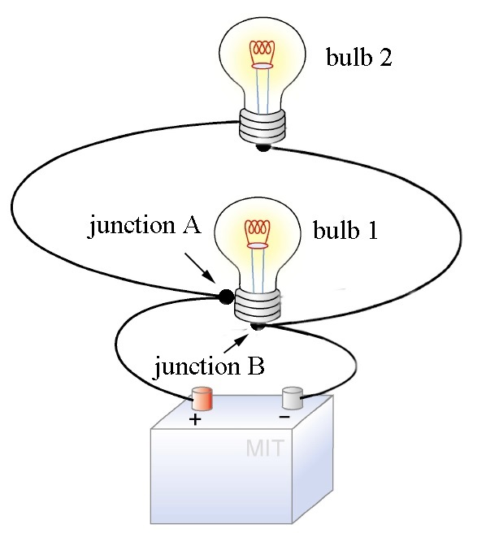
RESISTORS IN PARALLEL

Slide 15
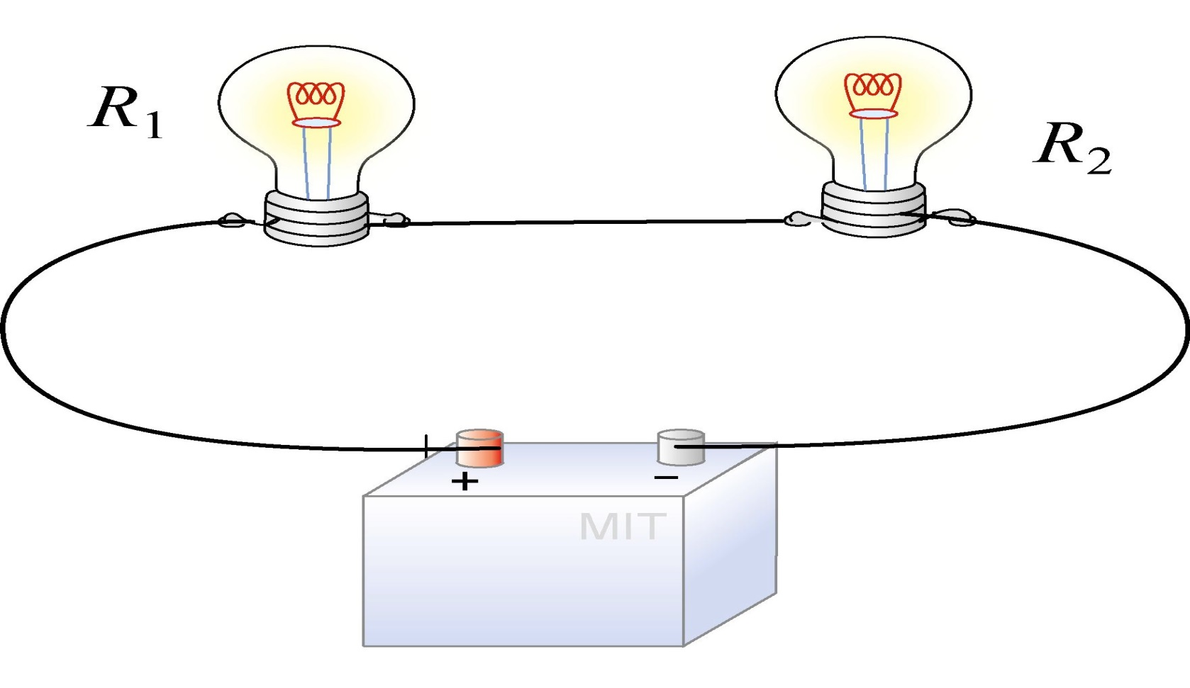
RESISTORS IN SERIES

Slide 16
RESISTORS IN SERIES
Resistors are in series when the same current flows through them. There is NO JUNCTION between them.
In Fig. 1 : R₁ and R₂ are in series
In Fig. 2: None of the resistors are in series

Slide 17
RESISTORS IN SERIES
Self assessment 1
Which of the following resistors are in series?
ANS: R₁&R₂, R₃ & R₄ and R₅ & R₆

Slide 18
RESISTORS IN SERIES
Total (effective) resistance of series resistors
The total resistance R_{T} for resistors R₁, R₂, R₃, ….., R_{N} which are in series is given by:

Slide 19
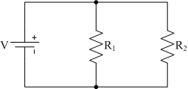
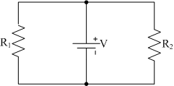
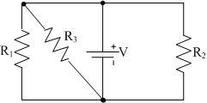
RESISTORS IN PARALLEL
Resistors are said to be in parallel when the voltage across them is the same.

Slide 20
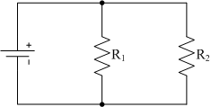
RESISTORS IN PARALLEL
Colloquially, TWO resistors are in parallel if it is possible to traverse them without passing through another element.

Slide 21
RESISTORS IN PARALLEL
Self assessment
Which of the resistors in the circuit below are in parallel?
ANS:

Slide 22
RESISTORS IN PARALLEL
Total resistance
When resistors R₁ and R₂ are in parallel, the total resistance R_{T} is given by:

Slide 23
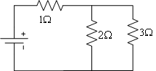
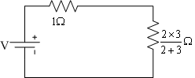
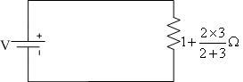
EFFECTIVE RESISTANCE OF A CIRCUIT
Effective circuit resistance is found by identifying and putting together series and or parallel resistors
Eg 1. Find the total resistance of the circuit below.
Solution

Slide 24
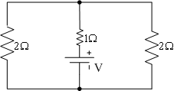
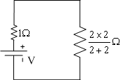
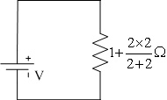
EFFECTIVE RESISTANCE OF A CIRCUIT
Eg. 2. Find the total resistance of the circuit below.
Solution

Slide 25
EFFECTIVE RESISTANCE OF A CIRCUIT
Self Assessment 1
Find the total resistance of the circuit below.
Answer

Slide 26
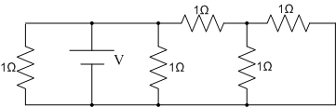
EFFECTIVE RESISTANCE OF A CIRCUIT
Self Assessment 2
Find the total resistance of the circuit below.
Answer

Slide 27
CURRENT DIVISION RULE
The current division rule is applied to share current between parallel branches. Consider the circuits below

Slide 28
CURRENT DIVISION RULE
Similarly,

Slide 29
CURRENT DIVISION RULE
Comparing currents

Slide 30
CURRENT DIVISION RULE
Consider the figure below,

Slide 31
CURRENT DIVISION RULE
Example 1
Find the values of I₁ and I₂ in the circuit below.
Solution

Slide 32
CURRENT DIVISION RULE
Example 2
Find the value of I₁ in the circuit below.
Solution

Slide 33
VOLTAGE DROP
Any time a voltage drives current through a resistor, some of the voltage drops across the resistor.
The magnitude of the drop is the product of the resistance and current

Slide 34
VOLTAGE DROP
Example
Find the values of I and R in the circuit below.
Solution
Voltage across 3Ω resistor = 10 – 4 = 6V
Current in 3Ω resistor = I = 6/3 = 2A
Resistance R = 4V/I = 4/2 = 2Ω

Slide 35
REVISION EXERCISE
Find the value of I in the circuit below.
Solution

Slide 36
REVISION EXERCISE

Slide 37
REVISION EXERCISE

Slide 38
Assignment 1
Find the value of the current in all resistors of the circuit below using total resistance and voltage drop principles. DO NOT use current division rule.
Submission date: God willing a week today
Submission time: Before lecture starts
Where to submit: Teaching Assistant’s office

Slide 39
KIRCHHOFF'S CURRENT LAW(KCL)
The Law
The sum of currents entering a node equals the sum of currents leaving the node.
Sum of currents entering
Sum of currents Leaving
Applying KCL

Slide 40
KIRCHHOFF'S CURRENT LAW(KCL)
Example
Find the value of i in the figure below.
Solution

Slide 41
KIRCHHOFF'S CURRENT LAW(KCL)
Self assessment
Find the value of i in the figure below.
ANS

Slide 42
KIRCHHOFF'S VOLTAGE LAW(KVL)
The law
The algebraic sum of the voltages in a loop (closed path) equals zero. Alternatively, in a loop, the algebraic sum of voltage sources equals the algebraic sum of voltage drops.
Loop abgha
Loop adeha

Slide 43
KIRCHHOFF'S VOLTAGE LAW(KVL)
Loop cbgfc
Loop acfha

Slide 44
KIRCHHOFF'S VOLTAGE LAW(KVL)
Example 1
Find the current in all parts of the circuit below.
Applying KVL to loop bcdab
Applying KVL to loop ecdfe

Slide 45
KIRCHHOFF'S VOLTAGE LAW(KVL)
Example 1
Find the current in all parts of the circuit below.
Applying KVL to loop bcdab
Applying KVL to loop ecdfe

Slide 46
KIRCHHOFF'S VOLTAGE LAW(KVL)
Applying KCL to node c:
Solving the equations simultaneously yields

Slide 47
KIRCHHOFF'S VOLTAGE LAW(KVL)
Example 2
Find the currents in all parts of the circuit below.
Solution
Apply KVL to loop cefdc

Slide 48
KIRCHHOFF'S VOLTAGE LAW(KVL)
Apply KVL to loop abcda:
Apply KVL to loop ghfeg:

Slide 49
KIRCHHOFF'S VOLTAGE LAW(KVL)
Solving the three equations:
Simultaneously,

Slide 50
Thevenin’s Theorem
Theorem:
Any linear circuit connected between two terminals can be replaced by a Thevenin’s voltage(V_{TH}) in series with a Thevenin's resistance (R_{TH}).
V_{TH} is the open-circuit voltage across the two terminals
R_{TH} is the resistance seen from the two terminals when all sources have been deactivated

Slide 51
Thevenin’s Theorem
To find the current through a resistor in a circuit, the following steps are taken:
Remove the resistor from the circuit and mark the two terminals.

Slide 52
Thevenin’s Theorem
2. Find the open-circuit voltage (V_{TH}) across the two terminals by applying KVL. Treat V_{TH} as a source.

Slide 53
Thevenin’s Theorem
3. Recall the circuit created before step 2 and deactivate all sources. Short-circuit voltage sources and Open-circuit current sources.

Slide 54


THEVENIN’S THEOREM
4. Find the total resistance of the circuit resulting from step 3 as seen from the two terminals

Slide 55
THEVENIN’S THEOREM
Reproduce the Thevenin’s equivalent circuit and connect the resistor whose current is to be found.

Slide 56
THEVENIN’S THEOREM
6. Calculate the current in the circuit in step 5. This is the current being sought.
I

Slide 57
THEVENIN’S THEOREM
Example 1
Using Thevenin’s theorem, determine the current in the 3-Ω resistor of the circuit below.
Solution
Steps 1 & 2

Slide 58
THEVENIN’S THEOREM
Applying KVL to loop dcbed:
Applying KVL to loop fabef:
a
b
c
f
e
d
(1)

Slide 59
THEVENIN’S THEOREM
Substituting for I in equation 1:
Steps 3 & 4

Slide 60
THEVENIN’S THEOREM
Steps 5 & 6

Slide 61
THEVENIN’S THEOREM
Example 2
Find the current in the 10-Ω resistor of the circuit below using Thevenin’s theorem.
Solution
Steps 1 & 2

Slide 62
THEVENIN’S THEOREM
Applying KVL to loop cbgfc:
Applying KVL to loop abgha:
Applying KVL to loop dcfed:
a
b
c
d
h
g
f
e
(1)

Slide 63
THEVENIN’S THEOREM
Substituting for I₁ and I₂ in equation 1 yields:
Steps 3 & 4

Slide 64
THEVENIN’S THEOREM
Steps 5 & 6

Slide 65
Assignment 2
Use Thevenin’s theorem to find the current in the 5Ω resistor of the circuit below.
Submission date: God willing a week today
Submission time: Before lecture starts
Where to submit: Teaching Assistant’s office

Slide 66
NORTON’S Theorem
Theorem:
Any linear circuit connected between two terminals can be replaced by a Norton’s current(I_{N}) in parallel with a Norton's resistance (R_{N}).
I_{N} is the short-circuit current between the two terminals
R_{N} is the resistance seen from the two terminals when all sources have been deactivated (R_{N} = R_{TH})

Slide 67
NORTON’S Theorem
To find the current through a resistor in a circuit, the following steps are taken:
Remove the resistor from the circuit and mark the two terminals.

Slide 68
NORTON’S Theorem
2. Find the short-circuit current (I_{N}) through the two terminals by applying KVL.

Slide 69
NORTON’S Theorem
3. Recall the circuit created before step 2 and deactivate all sources. Short-circuit voltage sources and Open-circuit current sources.

Slide 70
NORTON’S THEOREM
4. Find the total resistance of the circuit resulting from step 3 as seen from the two terminals

Slide 71
NORTON’S THEOREM
Reproduce the Norton’s equivalent circuit and connect the resistor whose current is to be found.

Slide 72
NORTON’S THEOREM
6. Calculate the current in the circuit in step 5. This is the current being sought for.
I

Slide 73
NORTON’S THEOREM
Example 1
Using Norton’s theorem, determine the current in the 3-Ω resistor of the circuit below.
Solution
Steps 1 & 2

Slide 74
NORTON’S THEOREM
Applying KVL to loop abefa:
Applying KVL to loop cbedc:
a
b
c
f
e
d
(1)

Slide 75
NORTON’S THEOREM
Substituting for I in equation 1:
Steps 3 & 4

Slide 76
NORTON’S THEOREM
Steps 5 & 6

Slide 77
NORTON’S THEOREM
Example 2
Determine the current in the load resistor R_{L}
Solution

Slide 78
NORTON’S THEOREM
Solution
Applying KCL

Slide 79
NORTON’S THEOREM
Finding R_{N}

Slide 80
NORTON’S THEOREM
Finding I_{L}

Slide 81
SUPERPOSITION THEOREM
The Theorem
The current through(or the voltage across) any element in a multiple-source linear circuit can be found by taking the algebraic sum of the current through(or the voltage across) that element due to each individual source acting alone.

Slide 82
SUPERPOSITION THEOREM
The Theorem
+

Slide 83
SUPERPOSITION THEOREM
Example 1
Use superposition theorem to find the current supplied by the 35V battery of the circuit below.
Solution
With the 42V battery acting alone,

Slide 84
SUPERPOSITION THEOREM
With the 35V battery acting alone,

Slide 85
SUPERPOSITION THEOREM
With both batteries acting,
=
+

Slide 86
RECIPROCITY THEOREM
The Theorem
An ideal ammeter and ideal voltage source when inserted in two different branches of a linear network can be interchanged without changing the reading of the ammeter
=

Slide 87
RECIPROCITY THEOREM
Similarly,
An ideal voltmeter and ideal current source when connected across two different branches of a network can be interchanged without changing the reading of the voltmeter.
=

Slide 88
RECIPROCITY THEOREM
Example 1
Jointly use superposition and reciprocity theorems to find the current supplied by the 35V battery of the circuit below.
Solution
With the 42V battery acting alone,

Slide 89
RECIPROCITY THEOREM
The second circuit to be solved is:
Applying the reciprocity theorem
is comparable to
=
A
B

Slide 90
RECIPROCITY THEOREM
Applying proportion,
is comparable to circuit B
If 42V = I^{A} =2A,
Then 35V =(35*2)/42=5/3A
Applying KVL,

Slide 91
RECIPROCITY THEOREM

Slide 92
Assignment 3
Use Norton’s theorem to find the current in the 2Ω resistor connected between e and f in the circuit below.
Submission date: God willing a week today
Submission time: Before lecture starts
Where to submit: Teaching Assistant’s office

Slide 93
DELTA-STAR TRANSFORMATION
The transformation is employed in situations where neither series nor parallel arrangements can be identified.
An arrangement of three(3) resistors where the resistors are connected to each other is a delta arrangement.

Slide 94
DELTA-STAR TRANSFORMATION
An arrangement of three(3) resistors where all resistors have a common point of connection through one terminal is a star(wye) arrangement.

Slide 95
DELTA-STAR TRANSFORMATION
A delta arrangement can be changed to star and vice versa using the following relations:

Slide 96
DELTA-STAR TRANSFORMATION
When all values are the same, delta values are 3 times star values

Slide 97
DELTA-STAR TRANSFORMATION
Example 1
Determine the voltage V₀ across the 6Ω resistor of the circuit below
Solution

Slide 98
DELTA-STAR TRANSFORMATION

Slide 99
Assignment 4
Use Norton’s theorem to find the current in the 3Ω resistor connected between points A and B of the circuit below.
Submission date: God willing a week today
Submission time: Before lecture starts
Where to submit: Teaching Assitant’s office

Slide 100
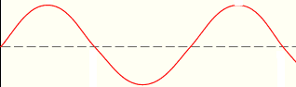
ALTERNATING CURRENT CIRCUITS
Alternating current (AC) circuits are circuits with currents and voltages which are time-varying
Examples of AC waveforms are:
Sine wave
Square wave
Triangular wave

Slide 101
TERMINOLOGIES IN AC CIRCUITS
Amplitude (peak): The maximum deviation of the function from its center position
Cycle: A repeating portion of a function (wave).
Period (T): The duration of a cycle
Frequency(f): The inverse of period.
A B C

Slide 102
AVERAGE VALUE
Average value: The average value of a periodic function is its dc value.
If
Then

Slide 103
AVERAGE VALUE
The following steps are followed when finding average values of waveforms:
Identify a cycle of the wave
Note the period
Find the area of the cycle
Divide the area by the period

Slide 104
ROOT MEAN SQUARE VALUE
The Root Mean Square (RMS) or Effective value of an alternating quantity is the value of a direct current which when flowing through a given resistance for a given time produces the same heat as produced by the alternating current when flowing through the same resistance.
The RMS value of an alternating current is:

Slide 105
ROOT MEAN SQUARE VALUE
The following steps are taken when finding the RMS value of a waveform :
Identify a cycle of the waveform
Note the period
Square the cycle
Find the area under the squared cycle
Divide the area by the period
Take the square root of the result

Slide 106
ROOT MEAN SQUARE VALUE
Example 1
Find the average and rms values of the waveform below.
Solution
Average Value
Cycle spans from 0 to 4
Period= 4s
Area of cycle

Slide 107
ROOT MEAN SQUARE VALUE

Slide 108
ROOT MEAN SQUARE VALUE
RMS value
Cycle spans 0 to 4
Period = 4s
Squared cycle
Area covered by squared cycle
Division of area by period

Slide 109
ROOT MEAN SQUARE VALUE
Taking square root

Slide 110
ROOT MEAN SQUARE VALUE
Example 2
Calculate the effective value of the voltage below.
Solution
Cycle spans from 0 to 2π
Area of sine part

Slide 111
ROOT MEAN SQUARE VALUE
Area of triangular part
Total area:
Mean

Slide 112
ROOT MEAN SQUARE VALUE
RMS value
Note:
The area of a squared right-angled triangular wave is

Slide 113
SINUSOIDAL VOLTAGES AND CURRENT
Voltages and currents of commercial ac generators have the following expressions:
or
is the peak voltage
is the frequency in Hz
is the angular frequency in radian per second. It specifies how many oscillations occur in a unit time interval

Slide 114
SINUSOIDAL VOLTAGES AND CURRENT
or
is the peak current
is the frequency in Hz
is the angular frequency in radian per second. It specifies how many oscillations occur in a unit time interval

Slide 115
RMS VALUE OF SINUSOIDAL QUANTITIES
The RMS value of a sinusoidal voltage
is given by:

Slide 116
RMS VALUE OF SINUSOIDAL QUANTITIES
Similarly,
The RMS value of a sinusoidal current
is given by:

Slide 117
RMS VALUE OF SINUSOIDAL QUANTITIES
Example 1
Find the rms values of the following quantities:
(a)
(b)
Solution
(a)
(b)

Slide 118
HARMONICS
Non-sinusoidal periodic voltages and currents can be expressed as the sum of sine waves in which the lowest frequency is f and all other frequencies are integral multiples of f.
For example, a square wave of amplitude E can be expressed as:

Slide 119
HARMONICS
Any quantity which contains multiple frequencies is a harmonic quantity.
The frequency of which others have been expressed as multiples of is the fundamental frequency.
An odd multiple of the fundamental is an odd harmonic.
An even multiple of the fundamental is an even harmonic.

Slide 120
RMS VALUE OF A HARMONIC QUANTITY
The effective value of a harmonic quantity is obtained by:
First obtaining the square of the rms value of each term
Adding the obtained squared rms values
Taking the square root of the sum

Slide 121
RMS VALUE OF A HARMONIC QUANTITY
Example
Find the RMS value of the current
Solution

Slide 122
PHASORS
Phasors are used to represent sinusoidal quantities to avoid drawing the sine waves.
A phasor is a straight line whose length is proportional to the rms voltage or current it represents.
To show the phase angle or phase displacement between voltages and currents, the phasors bear an arrow.

Slide 123
PHASORS
Two phasors are said to be in phase when they point in the same direction. The phase angle between them is then zero.

Slide 124
PHASORS
Two phasors are said to be out of phase when they point in different directions.
The phase angle between them is the angle through which one of them has to be rotated to make it point in the same direction as the other.

Slide 125
PHASOR DIAGRAMS
It is used to show at a glance the magnitude and phase relations among the various quantities within a network. This is often helpful in the analysis of the network.
Example
A 50 Hz source having rms voltage of 240 V delivers a rms current of 10 A to a circuit. The current lags the voltage by 30°. (a) Draw the phasor diagram for the circuit. (b) Express the voltage and current as functions of time.

Slide 126
PHASOR DIAGRAMS
Solution
(a) Take V as the reference
(b)

Slide 127
ADDITION AND SUBTRACTION OF SINUSOIDAL QUANTITIES
The sum of sinusoidal quantities is obtained by taking the vector sum of their phasors.
The difference of sinusoidal quantities is obtained by first reversing the subtracted quantity and adding it as a vector to the other phasors.
A sinusoidal quantity is reversed by adding 180⁰ to its angle
Only sinusoidal quantities of the SAME FREQUENCY can be added or subtracted.

Slide 128
ADDITION AND SUBTRACTION OF SINUSOIDAL QUANTITIES
Example 1
Let v₁(t) = 60 sin ωt and v₂(t) = 80 sin (ωt – 90°). Determine (a) v₁ + v₂ and (b) v₁ – v₂
Solution
(a) Phasor diagram

Slide 129
ADDITION AND SUBTRACTION OF SINUSOIDAL QUANTITIES
(b)
Phasor diagram

Slide 130
ADDITION AND SUBTRACTION OF SINUSOIDAL QUANTITIES

Slide 131
ADDITION AND SUBTRACTION OF SINUSOIDAL QUANTITIES
Example 2
Four conductors meet at a junction. The following relationship exists between them.
Find the value of given that

Slide 132
ADDITION AND SUBTRACTION OF SINUSOIDAL QUANTITIES
Solution
(a) There are two different frequencies. They must therefore be added separately.
Addition of part.
X-component
Y-component

Slide 133
ADDITION AND SUBTRACTION OF SINUSOIDAL QUANTITIES
Amplitude
Angle
Therefore, part of is

Slide 134
ADDITION AND SUBTRACTION OF SINUSOIDAL QUANTITIES
Addition of part.
X-component
Y-component
Amplitude

Slide 135
ADDITION AND SUBTRACTION OF SINUSOIDAL QUANTITIES
Angle
Therefore, part of is
Hence

Slide 136
ASSIGNMENT 5
Four circuit elements are connected in series across a sinusoidal alternating voltage given by . The instantaneous voltage across three of the elements are given by
(a)Determine the expression for the fourth voltage in the form
(b) What is the r.m.s. value of v₄?
Use phasor diagrams. DO NOT use complex number approach

Slide 137
IMPEDANCE (Z)
The opposition to current flow in ac circuits owing to the presence of combinations of resistive, inductive and capacitive elements.
Opposition due to inductance (L) is called inductive reactance(X_{L}).
Opposition due to capacitance is called capacitive reactance(X_{C}).

Slide 138
IMPEDANCE (Z)
Phase relationship between the current and voltage in a resistor
Let
It is noted that the voltage across and the current through a resistor are in phase.

Slide 139
IMPEDANCE (Z)
Phase relationship between the current and voltage in an inductor
Let
It is noted that the current through an inductor lags the voltage by 90⁰.

Slide 140
IMPEDANCE (Z)
Phase relationship between the current and voltage in a capacitor
Let
It is noted that the current through a capacitor leads the voltage by 90⁰.

Slide 141
IMPEDANCE (Z)
Series circuit containing R and L

Slide 142
IMPEDANCE (Z)
Phase angle between current and voltage in a series RL circuit
The current in a series RL circuit lags the voltage but not by 90⁰

Slide 143
IMPEDANCE (Z)
Series circuit containing R and C

Slide 144
IMPEDANCE (Z)
Phase angle between current and voltage in a series RC circuit
The current in a series RC circuit leads the voltage but not by 90⁰

Slide 145
IMPEDANCE (Z)
Series circuit containing R, L and C

Slide 146
IMPEDANCE (Z)

Slide 147
IMPEDANCE (Z)
Phase angle between current and voltage in a series RLC circuit
Current in a series RLC circuit may lead or lag the voltage depending on the relative values of X_{L}
and X_{C}

Slide 148
IMPEDANCE (Z)
Example 1
A coil has R=12Ω and L=0.1H. It is connected across a 100V, 50Hz supply. Calculate (a) the reactance and impedance of the coil (b) the current and (c) the phase difference or angle between the current and the applied voltage.
Solution
(a)

Slide 149
IMPEDANCE (Z)
(b)
(c)

Slide 150
IMPEDANCE (Z)
Example 2
A metal filament lamp, rated at 750W, 100V is to be connected in series with a capacitor across a 230V, 50Hz supply. Calculate (a) the capacitance required and (b) the phase angle between the current and supply voltage.
Solution
(a)

Slide 151
IMPEDANCE (Z)
(a)
Hence,

Slide 152
IMPEDANCE (Z)
(b)

Slide 153
POWER IN AC CIRCUITS
There are three kinds of power in ac circuits
Apparent Power (S) which is measured in Volt-amperes (VA)
Active Power (P) which is measured in Watts (W).
Active Power is also called Actual Power, Useful Power, True Power, Real Power or simply, Power
3. Reactive Power (Q) which is measured in Volt-amperes reactive (VAR)

Slide 154
POWER IN AC CIRCUITS
The following relationships exist between S, P and Q
is called power factor (pf)

Slide 155
POWER IN AC CIRCUITS
Power factor may be said to be lagging or leading.
Power factor is lagging when current lags voltage
Power factor is leading when current leads voltage

Slide 156
POWER IN AC CIRCUITS
Relationships between the three passive elements , P and Q.
Resistors consume only P
Inductors consume only Q
Capacitors do not consume P and Q. They rather supply Q or reduce the consumption of Q.

Slide 157
POWER IN AC CIRCUITS
Example 1
A single-phase motor connected to a 400-V, 50-Hz supply is developing 10 kW with efficiency of 84 per cent and a power factor of 0.7 lagging. Calculate (a) the input kVA (b) the active and reactive components of the current and (c) the reactive kVA.
Solution
(a)

Slide 158
POWER IN AC CIRCUITS
(b)

Slide 159
POWER IN AC CIRCUITS
(b)

Slide 160
POWER IN AC CIRCUITS
Example 2
An emf whose instantaneous value is given by 283sin(314t + π/4)V is applied to an inductive circuit and the current in the circuit is 5.66sin(314t – π/6)A. Determine (a) the frequency of the emf (b) the R and L (c) the power absorbed.
Solution
(a)
(b)

Slide 161
POWER IN AC CIRCUITS
(b)

Slide 162
POWER IN AC CIRCUITS
(c)

Slide 163
USING COMPLEX NUMBERS TO SOLVE AC CIRCUIT PROBLEMS
The ability to make a vector quantity appear as a scalar quantity using complex numbers is utilized in the analysis of ac circuits.
All the mathematical manipulations in complex algebra hold when employing complex numbers in analyzing ac circuits.
The operator ‘i’ is replaced with ‘j’ in other to avoid confusing it with current.

Slide 164
USING COMPLEX NUMBERS TO SOLVE AC CIRCUIT PROBLEMS
The three passive elements are represented as follows:
as a complex number is
as a complex number is
as a complex number is
Series impedance

Slide 165
USING COMPLEX NUMBERS TO SOLVE AC CIRCUIT PROBLEMS
Example 1
Express in rectangular and polar notations, the impedance of each of the following circuits at a frequency of 50 Hz: (a) a resistance of 20 Ω (b) a resistance of 20 Ω in series with an inductance of 0.1 H (c) a resistance of 50 Ω in series with a capacitance of 40 μF.
Solution
(a)
(b)

Slide 166
USING COMPLEX NUMBERS TO SOLVE AC CIRCUIT PROBLEMS
(c)

Slide 167
USING COMPLEX NUMBERS TO SOLVE AC CIRCUIT PROBLEMS
Example 2
A circuit is arranged as indicated in the figure below, the values being as shown. Calculate the value of the current in each branch and its phase relative to the supply voltage.
Solution

Slide 168
USING COMPLEX NUMBERS TO SOLVE AC CIRCUIT PROBLEMS
Choosing the voltage as the reference phasor,

Slide 169
USING COMPLEX NUMBERS TO SOLVE AC CIRCUIT PROBLEMS
Current leads supply voltage by 44.2⁰
Current leads supply voltage by 73.68⁰

Slide 170
USING COMPLEX NUMBERS TO SOLVE AC CIRCUIT PROBLEMS
Current lags supply voltage by 7.27⁰

Slide 171
USING COMPLEX NUMBERS TO SOLVE AC CIRCUIT PROBLEMS
Q is positive when the current lags the voltage
Q is negative when the current leads the voltage

Slide 172
CALCULATION OF COMPLEX POWER
Example 1
The potential difference across and the current in a circuit are represented by 100 + j200 v and 10 + j5 a respectively. Calculate the power and reactive voltamperes (or vars).
Solution

Slide 173
CALCULATION OF COMPLEX POWER
Example 2
A small installation consists of the following loads connected in parallel across a single-phase 240V, 50Hz supply:
(a) a fan motor taking an input of 1.5kVA at 0.75pf lag,
(b) a 1000W radiator operating at unity power factor
(c) a number of fluorescent lamps taking a total load of 1.2kVA at 0.95pf lagging
Find the total current, kW, kVA and power factor of the load.

Slide 174
CALCULATION OF COMPLEX POWER
Solution
The problem is solved by obtaining the active and reactive component of each load and then summing all reactive components and all active components
Load (kVA) | cosϕ | P(kW) = Scosϕ | sinϕ | Q(kVAR) = Ssinϕ
TOTAL

Slide 175
CALCULATION OF COMPLEX POWER

Slide 176
CALCULATION OF COMPLEX POWER
NOTE
In the problem above, if one load had a leading power factor, then its Q would have a negative sign and thus would have subtracted from the others.

Slide 177
Assignment 6
A small installation consists of the following loads connected in parallel across a single-phase 240V, 50Hz supply:
(a) a fan motor having an input of 2kVA at 0.75pf lag,
(b) a 1.5kW radiator operating at unity power factor,
(c) a 1kVA load operating 0.85 leading power factor.
Find the total current, kW, kVA and power factor of the load.
Submission date: God willing a week today
Submission time: Before lecture starts
Where to submit: Teaching Assistant’s office

Slide 178
THREE-PHASE CIRCUITS
A single-phase generator produces a single sinusoidal voltage.
A 3-phase generator on the other hand produces three equal voltages which are out of phase with one another by 120º.
The three voltages are generated in three separate windings arranged in a special way in the machine.

Slide 179
THREE-PHASE CIRCUITS
A 3-phase system is a power supply system consisting of three voltages which are 120º out of phase with one another.
Three-phase systems have the following advantages over single phase systems
Three-phase motors, generators and transformers are simpler, cheaper and more efficient
Three-phase transmission lines can deliver more power for a given weight and cost

Slide 180
THREE-PHASE CIRCUITS
The voltage regulation of three-phase transmission lines is inherently better
A 1-phase supply can be obtained from a 3-phase one

Slide 181
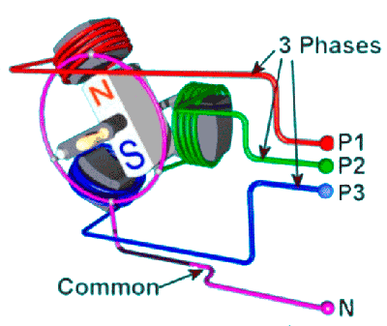
Winding arrangement of a three-phase generator

Slide 182
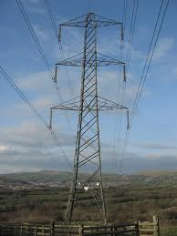
A three-phase transmission line

Slide 183
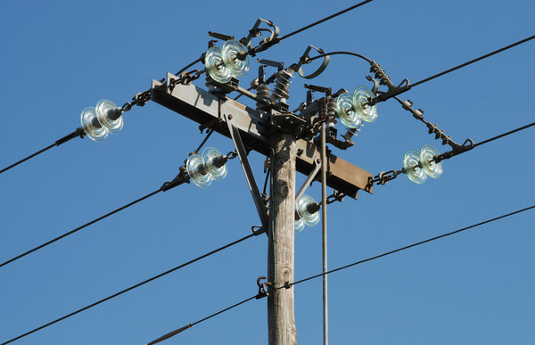
11 kV Distribution Feeder

Slide 184
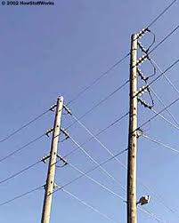
A Distribution Line

Slide 185
THREE-PHASE CIRCUITS
The two main connections of three-phase windings
A star arrangement where all winding have a common point
Letters a, b and c , colours red (R), yellow (Y) and blue (B) or numbers 1, 2 and 3 are used to name the windings

Slide 186
THREE-PHASE CIRCUITS
2. A delta arrangement where all winding are connected to each other
Letters a, b and c , colours red (R), yellow(Y) and blue (B) or numbers 1, 2 and 3 are used to name the windings

Slide 187
THREE-PHASE CIRCUITS
The phasor diagram for the three-voltages (in star or delta) is indicated below.

Slide 188
THREE-PHASE CIRCUITS
Line and phase voltages
The voltage from one line to another is called a line-to-line voltage or simple a line voltage
The voltage across each winding is a phase voltage
On a phasor diagram, a line voltage is drawn from the end of one phase to another in the anti clockwise direction

Slide 189
THREE-PHASE CIRCUITS
Relationship between line and phase voltages for a star connection
Hence, for a star connection, the line voltage is times the phase voltage.

Slide 190
THREE-PHASE CIRCUITS
Relationship between Line and phase voltages for a delta connection

Slide 191
THREE-PHASE CIRCUITS
Relationship between Line and phase current for a star connection

Slide 192
THREE-PHASE CIRCUITS
Relationship between Line and phase currents for a delta connection
Hence, for a delta connection, the line current is times the phase current

Slide 193
THREE-PHASE CIRCUITS
Analysis of three-phase balanced circuits
A balanced three-phase circuit is that in which identical loads are connected in each phase.
The currents that flow in a balanced three-phase system are equal in magnitude and also 120° out of phase.
A balanced three-phase circuit is analysed by considering just one phase
When finding total power, the per phase power is multiplied by three
1-phase power factor is the same as 3-phase

Slide 194
THREE-PHASE CIRCUITS
Example 1
Three identical resistors are connected in star across a 3-phase, 415-V supply. If each resistor has a resistance of 50 ohms, calculate (a) the voltage across each resistor (b) the current in each resistor (c) the total power supplied to the load
Solution
(a)
(b)

Slide 195
THREE-PHASE CIRCUITS
(c)

Slide 196
THREE-PHASE CIRCUITS
Example 2
Three identical impedances are connected in delta across a 3-phase, 415-V supply. If the line current is 10 A, calculate (a) the current in each impedance (b) the value of each impedance.
Solution
(a)
(b)

Slide 197
THREE-PHASE CIRCUITS
Example 3
A 3-phase, 450-V system supplies a balanced delta-connected load of 12 kW at 0.8 power factor lagging. Calculate (a) the phase currents (b) the line currents and (c) the effective impedance per phase.
Solution
(a)

Slide 198
THREE-PHASE CIRCUITS
(b)
(c)

Slide 199
THREE-PHASE CIRCUITS
Power in three-phase circuits
The total apparent power of a balanced three-phase circuit (star or delta) is given by:
The total active power of a balanced three-phase circuit (star or delta) is given by:
The total reactive power of a balanced three-phase circuit (star or delta) is given by:

Slide 200
THREE-PHASE CIRCUITS
Analysis of parallel balanced three-phase circuit problems
When the parallel loads are not of the same kind(say one is delta and the other is star), then they must be changed either all to star or all to delta.
When all are in star, the circuit is analyzed by taking one phase of each and applying the star characteristics.
When all are in delta, the circuit is analyzed by taking one phase of each and applying the delta characteristics.

Slide 201
THREE-PHASE CIRCUITS
Parallel circuits are better analysed by reverting to complex numbers.
Example 1
A Y-connected impedance Z₁ = 20.0 + j37.75 Ω per phase is connected in parallel with ∆-connected impedance Z₂ = 30.0 – j159.3 Ω per phase. For an impressed 3-phase voltage of 398 V line to line, compute the line current, power factor and the power taken by the parallel combination.
Solution
The circuit is solved by making all star.

Slide 202
THREE-PHASE CIRCUITS
Y-connected impedance Z₁ = 20.0 + j37.75 Ω
∆-connected impedance Z₂ = 30.0 – j159.3 Ω
Changing the delta to star

Slide 203
THREE-PHASE CIRCUITS

Slide 204
THREE-PHASE CIRCUITS
Example 2
A manufacturing plant draws 415 kVA from a 2400 V, 3-phase line. If the plant power factor is 0.875 lagging, calculate (a) the impedance of the plant per phase (b) the phase angle between the phase voltage and phase current.
Solution
The load is considered to be star.
(a)

Slide 205
THREE-PHASE CIRCUITS

Slide 206
THREE-PHASE CIRCUITS
Example 3
A star-connected motor is connected to a 4000 V, 3-phase, 50 Hz line. The motor produces an output power of 2681 kW at efficiency of 93 % and a power factor of 0.9 lagging. Calculate (a) the active power absorbed by the motor, (b) the reactive power absorbed by the motor, (c) the apparent power supplied by the transmission line and (d) the motor line current.
Solution
(a)

Slide 207
THREE-PHASE CIRCUITS
(a)
(b)
(c)

Slide 208
THREE-PHASE CIRCUITS
(d)

Slide 209
THREE-PHASE CIRCUITS
(a)Three-phase four-wire feeding unbalanced star-connected loads
Three-phase unbalanced load does not have the same impedance in all the three phases.
The neutral points of the source and the load are the same, so the voltage across each phase of the load is the phase voltage of the source
Three-phase four wire is usually used for low-voltage power distribution
The neutral carries current if the load is unbalanced

Slide 210
THREE-PHASE CIRCUITS
Each phase is analyzed separately when the load is unbalanced
Example 1
A three-phase four-wire system has the following data: Supply voltage is 415 V, Z₁ = 8 + j0 Ω, Z₂ = 0 - j8 Ω and Z₃ = 0 + j8 Ω. Determine the load currents and the current in the neutral.
Solution

Slide 211
THREE-PHASE CIRCUITS

Slide 212
THREE-PHASE CIRCUITS

Slide 213
THREE-PHASE CIRCUITS
Example 2
In a three-phase four-wire system, the line voltage is 400V and resistive loads of 10 kW, 8 kW and 5 kW are connected between the three lines and neutral. Calculate (a) the current in each line and (b) the current in the neutral conductor.
Solution
(a)

Slide 214
THREE-PHASE CIRCUITS
Let I_{a}, I_{b} and I_{c} be the currents drawn by the 10kW, 8kW and 5kW loads respectively.

Slide 215
THREE-PHASE CIRCUITS

Slide 216
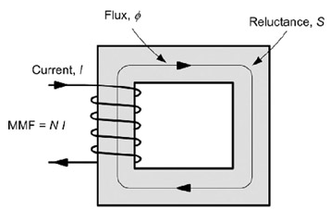
MAGNETIC CIRCUITS
A magnetic circuit is a closed path followed by any group of lines of magnetic flux.
Magnetic circuits are created with coils and ferromagnetic (iron, cobalt, nickel, etc) or permanent magnetic materials.

Slide 217
MAGNETIC CIRCUITS
Terminologies in magnetic circuits
Flux(ϕ)
It is a measure of the amount of magnetic field passing through a given surface. The SI unit of flux is Weber(Wb).
Flux density (B)
It is the flux per unit area. It is the flux divided by the cross-sectional area. The SI unit is Weber per square meter (Wb/m²) or Tesla (T)

Slide 218
MAGNETIC CIRCUITS
Terminologies in magnetic circuits
Magnetomotive force (F)
It is the source which sets up the flux flowing around a magnetic circuit. The unit is Amperes (A) or Ampere-turns(AT). It is the product of current in coil and number of turns of coil

Slide 219
MAGNETIC CIRCUITS
Reluctance(S or )
It is likened to resistance. It is the opposition offered by a material to the flow of magnetic flux.
is the length of the magnetic path in meters (m)
is the cross sectional area in square meter (m²)
The unit of reluctance is ampere-turns per weber (AT/Wb)

Slide 220
MAGNETIC CIRCUITS
Terminologies in magnetic circuits
Magnetic field intensity (H)
It is the mmf per unit length. The unit is Amperes per meter (A/m)or Ampere-Turns per meter (AT/m)

Slide 221
MAGNETIC CIRCUITS
B-H curves
They are curves which show the relation between magnetic flux density and magnetic field intensity for various materials
The B-H curve of vacuum is as shown
is a constant called magnetic
constant or permeability of free
space

Slide 222
MAGNETIC CIRCUITS
B-H curve of non-magnetic materials
The B-H curves are almost identical to that of vacuum.

Slide 223
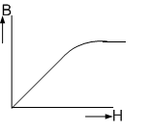
MAGNETIC CIRCUITS
B-H curve of magnetic materials
The B-H curves have linear, non-linear and saturation regions
is a the relative permeability
of the magnetic material.
The above formula only works for the linear region.

Slide 224
MAGNETIC CIRCUITS
Analysis of linear magnetic circuits
Magnetic circuits are analyzed by drawing an equivalent electric circuit and applying the laws used to analyze electric circuits. The following similarities exit.
Flux is similar to current
Magnetomotive force is similar to electromotive force
Reluctance is similar to resistance

Slide 225
MAGNETIC CIRCUITS
Analysis of non-linear magnetic circuits
Not all the laws of electric circuits can be applied to magnetic circuits. Kirchoff’s laws are applicable and when applied to magnetic circuits are stated as follows:
First law: The total magnetic flux towards a junction is equal to the total magnetic flux away from that junction.
Second law: In any closed magnetic circuit, the algebraic sum of the product of magnetic field strength and the length of each part of the circuit is equal to the resultant magnetomotive force.

Slide 226
MAGNETIC CIRCUITS
Example 1
A 600-turn coil carrying a current of 0.2A sets up a flux of 200mWb in a magnetic circuit. (i) What is the mmf in amperes developed in the circuit?
(ii) Determine the total reluctance of the circuit.

Slide 227
MAGNETIC CIRCUITS
Example 2
The figure below shows the equivalent electric circuit of a three-part magnetic circuit energised by a 100-turn coil carrying a current of 1A. The mmf drop across part ‘b’ is 40AT

Slide 228
MAGNETIC CIRCUITS
Calculate the flux in part c.
Determine the reluctance of parts b and c.
Obtain the flux density in part b if the cross sectional area of the material used is 0.05m².

Slide 229
LINEAR MAGNETIC CIRCUIT PROBLEMS
Example 1
A magnetic circuit comprises three parts in series each of uniform cross section. They are (a) a length of 80 mm and cross sectional area 50mm² (b) a length of 60mm and cross sectional area 90 mm² (c) an air gap of length 0.5 mm and cross sectional area 150mm² . A coil of 4000 turns is wound on part (b) and the flux density in the air gap is 0.3 T. Assuming that all the flux passes through the given circuit and that the relative permeability of section (a) and (b) is μ_{r} = 3000, estimate the coil current to produce such a flux density.

Slide 230
MAGNETIC CIRCUITS
Solution
The electric analogue circuit is shown below.

Slide 231
MAGNETIC CIRCUITS

Slide 232
MAGNETIC CIRCUITS
Example 2
A steel ring of cross-sectional area 50mm² has an air gap of 2mm and of the same cross-sectional area as shown in Fig. 4.5.a. The coil shown has 2000 turns with current 10 A. If the mean radius of the steel ring is 5cm and μ_{r} = 800, calculate (a) the total reluctance of the circuit (b) the flux Φ in the ring.
Solution
(a) The equivalent electric
circuit is as shown

Slide 233
MAGNETIC CIRCUITS

Slide 234
MAGNETIC CIRCUITS
Total reluctance
(b)

Slide 235
MAGNETIC CIRCUITS
Example 3
It is desired to produce a magnetic field of 1 Wb/m² in the air gap of the electromagnet shown in Example 2. The cross section of the iron is 1 cm², the mean length L_{i} + L_{g} = 10 cm, gap length L_{g} = 5 mm, and from the B-H curve of the iron μ_{r} was found to be 500 at B = 1 Wb/m². Calculate the m.m.f. required.
Solution

Slide 236
MAGNETIC CIRCUITS

Slide 237
MAGNETIC CIRCUITS
Example4
A coil of 1500 turns is wound on a circular wooden former which has a mean circumference of 30cm and a cross-sectional area of 4cm². Calculate (a) the flux density in the ring when the coil carries a current of 0.4 A (b) the flux in the ring in webers.
When the wooden former was replaced with a steel former of the same dimensions, the total flux became 600μWb for a current of 0.4 A. Calculate the relative permeability of the steel and the reluctance of the magnetic circuit at this flux density.

Slide 238
MAGNETIC CIRCUITS
Solution
A coil of 1500 turns is wound on a circular wooden
(a)

Slide 239
MAGNETIC CIRCUITS
With the magnetic former

Slide 240
THE END

